Slide 1
MASK DETECTOR
Presented by
Team : 19C008,19C016,19C057,19C061
Department : Computer Science Engineering
College: TCE

Slide 2
S.No | Name of the Team Member | Reg.No | Roles and Responsibilities
1 | Nishok Anand B | 19C061 | IDENTIFYING STAKE HOLDERS
2 | Nandhakumar Raj S | 19C057 | VOICE OF CUSTOMER
3 | Dhanushwaran P S | 19C016 | FINDING EXISTING PROBLEMS AND FINDING RELATED PATENTS
4 | Arvin Danny C S | 19C008 | PREPARING PROBLEM EVALUVATION

Slide 3
OVERVIEW
Introduction
Societal Need/Need Assessment
Motivation/Purpose of the work and To whom
Existing/Current status
Patents
Publications (Reputed Journals/Conferences)
Voice of customer
Existing market products
Problem Formulation
Objectives
Scope and Constraints
Identification of Community Partner and Stakeholders

Slide 4
INTRODUCTION
The coronavirus COVID-19 pandemic is the defining global health crisis of our time.
It spreads primarily when people are in close contact and one person inhales small droplets produced by an infected person.
The cheapest and one of the most effective method of prevention is to wear a mask.

Slide 5


Slide 6
APPLICATIONS/SOCIETAL NEED
CDC recommends that people wear masks in public settings and when around people who don’t live in your household, especially when other social distancing measures are difficult to maintain.
Masks may help prevent people who have COVID-19 from spreading the virus to others.
Masks are most likely to reduce the spread of COVID-19 when they are widely used by people in public settings.
Masks with exhalation valves or vents should NOT be worn to help prevent the person wearing the mask from spreading COVID-19 to others (source control).

Slide 7
MOTIVATION
The ultimate aim of this project -> to make everyone wear mask.
The blackmark feature (in workspace) allows others to be safe around those who most likely forget to wear mask often.
It also notifies people who wears masks in a lethargic way (wearing mask for only mouth and so on).
This in turn leads us to a safer environment.

Slide 8
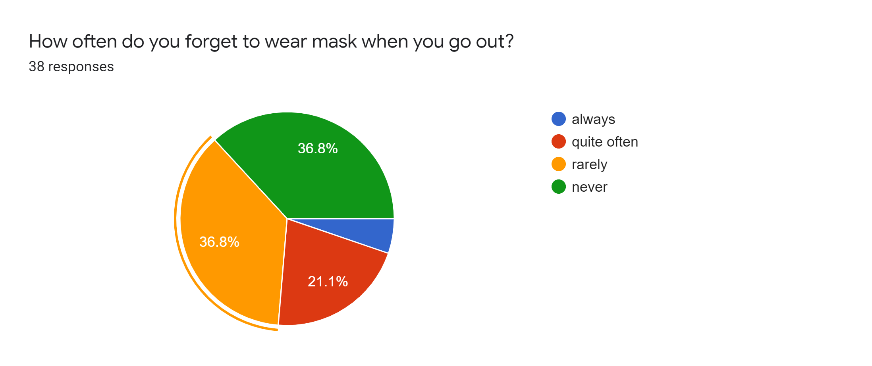
Before our project:

Slide 9
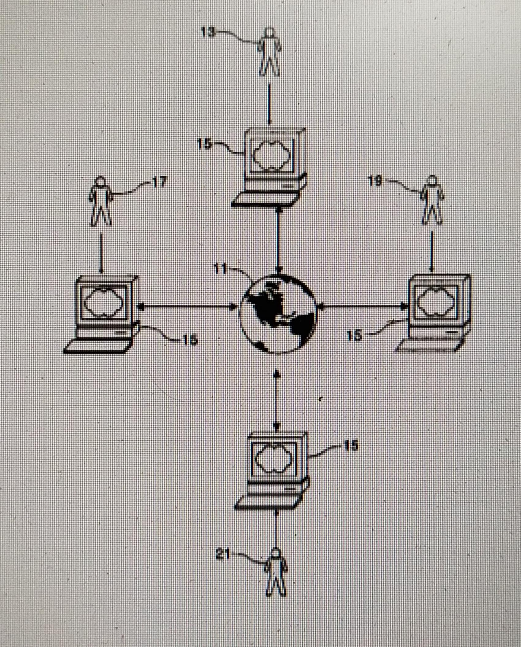
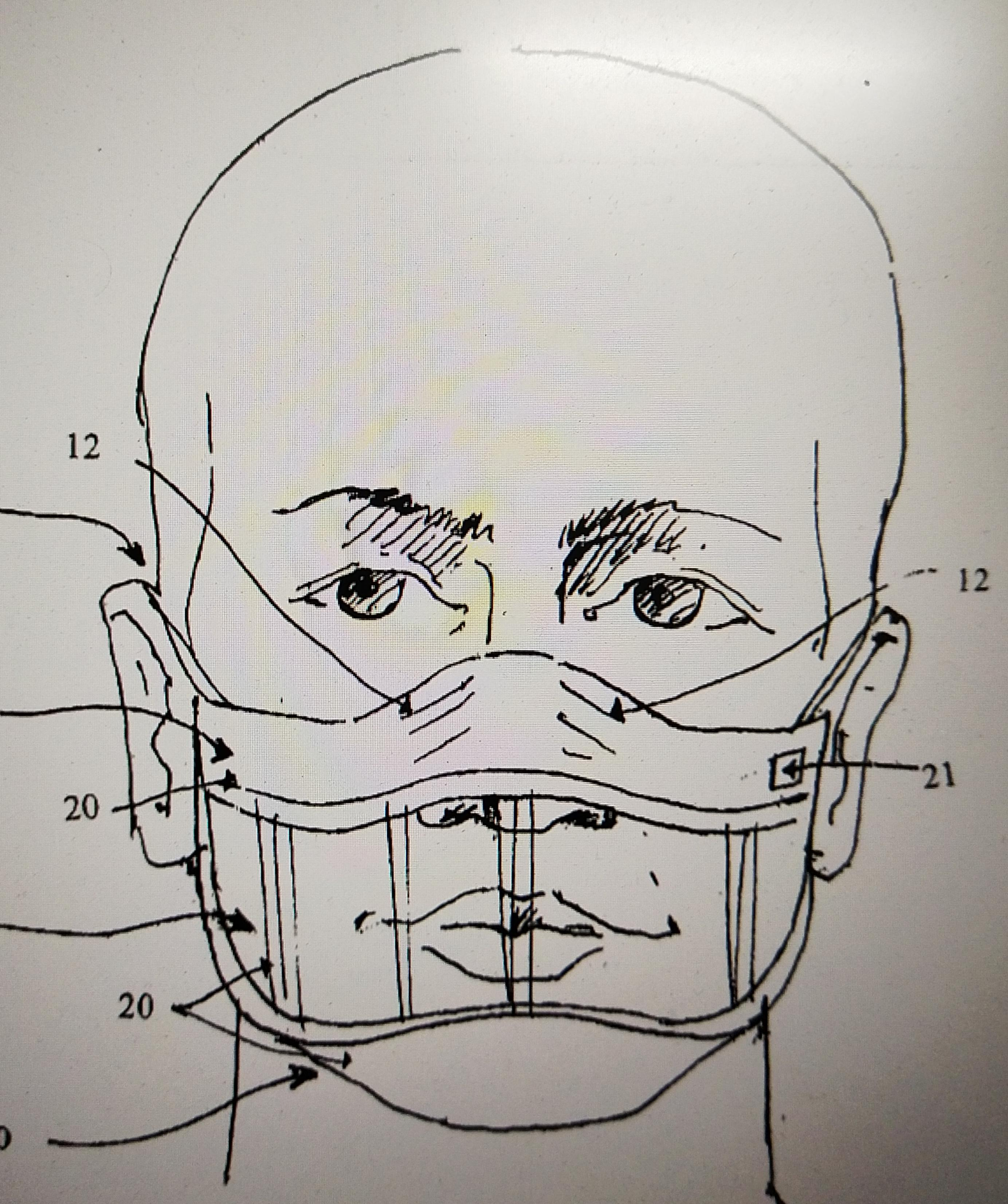
PATENTS
PATENT NUMBER/FILE | INVENTOR | APPLICATIONS | DIAGRAM
1.US 9,639,740 B2 2.5,781,650 3.US 2008/0092909 A1 | Ray Ganong &his team Neil Lobo; Young Kwon Jeanne Hahne | Applied Recognition of face Automatic feature detection in face Mask detector
9

Slide 10
LITERATURE REVIEW
S.No | Author | Title | Name Journal | Year | Method
1 | Wen,Chenyen & Chiu, Shih-Hsuan & Tseng, Yi-Ren & Lu, Chuan-Pin. | The Mask Detection with unique method | Journal of forensic sciences. ID: 50. 593-601. 10.1520/JFS2004409. | 2005 | the technology can assist face detection in the automatic face recognition system. Experimental results show the performance and reliability of the proposed technology.

Slide 11
VOICE OF CUSTOMER
SURVEY LINK:
https://drive.google.com/file/d/1faio-GSeBUak6g55MDLXSMlrWMAdY5fe/view?usp=sharing
INFERENCE:

Slide 12
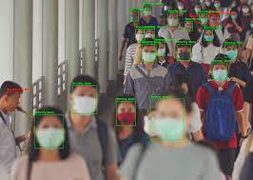
EXISTING MARKET PRODUCTS
Product Name: Aerial tronicns
Product Description:
Available only in America
Uses machine learning
Limitation:
Can't identify unique persons in workspace
About page :https://www.aerialtronics.com/en/products/face-mask-detection-software#facedetectionintro

Slide 13
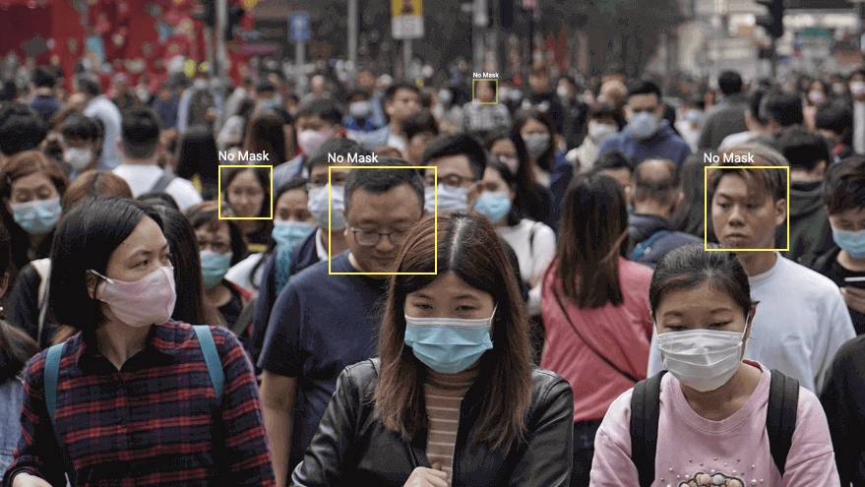
PROBLEM FORMULATION
CREATING A SOFTWARE THAT DETECTS PEOPLE WHO DOES NOT WEAR FACE MASK.
TO REDUCE THE SPREAD OF CONTAGIOUS DISEASES.

Slide 14
SCOPE/CONSTRAINTS
SCOPE:
Identify face mask usage.
Prevent contagious disease.
Mandatory use of face-mask.
CONSTRAINTS:
Cost
High-definition camera
Data storage
Minute-error while detection

Slide 15
OBJECTIVES
Based on the problems formulated, the objectives are
Work Place:
To identify defaulters and create a black mark list.
Public Place:
To locate the defaulters and alarm/notify the authority.
Wearing Mask as Mandatory practice.

Slide 16
IDENTIFICATION OF COMMUNITY PARTNER AND STAKEHOLDERS
The project can be implemented in three places:
Public places:
Partners => Respective authorities
Stakeholders => Customers and visitors
Companies and offices:
Partners => Managers and Directors
Stakeholders => Employees
Schools and Universities:
Partners => Management
Stakeholders => staffs and students

Slide 17
STAKEHOLDER’S REQUIREMENTS
Strategically placed cameras.
Storage devices for storing the data.
Database of faces of employees and students in case of workspace and educational institutes respectively.
Decent build system

Slide 18


STAKEHOLDERS PROFILES
Persona:
Age above 18:
VISHGAN
2. SOORYA
Recording
VISHAGAN
SOORYA

Slide 19

STAKEHOLDERS PROFILES
Persona:
Age above 25:
JEYALAKSHMI S
SENTHILVELU P
Recording
JEYALAKSHMI S
SENTHILVELU P

Slide 20
STAKEHOLDERS PROFILES
Persona:
Age above 40:
BALASUNDAR K
KALIYAPERMAL G
Recording
BALASUNDAR K
KALIYAPERMAL G

Slide 21
Understand and describe context (current situation and environment)
Specifications:
Requires security cameras that can clearly capture the faces.
Requires a computer.
Requires an alarm (in the case of public places).
Requires the data of staff/students (in case of private places).
Design targets:
UI is simple and hence can be used by anyone.
Since the notifications are through whatsapp, no additional apps are needed to be downloaded.
The program cost will be significantly lower in the markets.
.

Slide 22

Create stakeholder profiles
Stakeholder Requirements
From the interactions with the stakeholders, we came to know that they require a safe workplace/environment and are looking for ways to curb discrepancies.
They require some mechanism to monitor people at all times as it is not practically feasible for a human to do and even if so, it requires a lot of work force.

Slide 23
Create stakeholder profiles
2. Stakeholder Expectations:
Should be easily installed and should start working immediately.
Should be easy to operate.
Should be cost efficient.
Should have less possibilities of errors in recognizing a person.
Should not require much man work.

Slide 24
Create stakeholder profiles
3. Stakeholder Analysis:
People need a safe environment and to achieve that, they need a system which is flexible to use and can easily find the defaulters
12/15/2020
Design Thinking_Review I
24

Slide 25
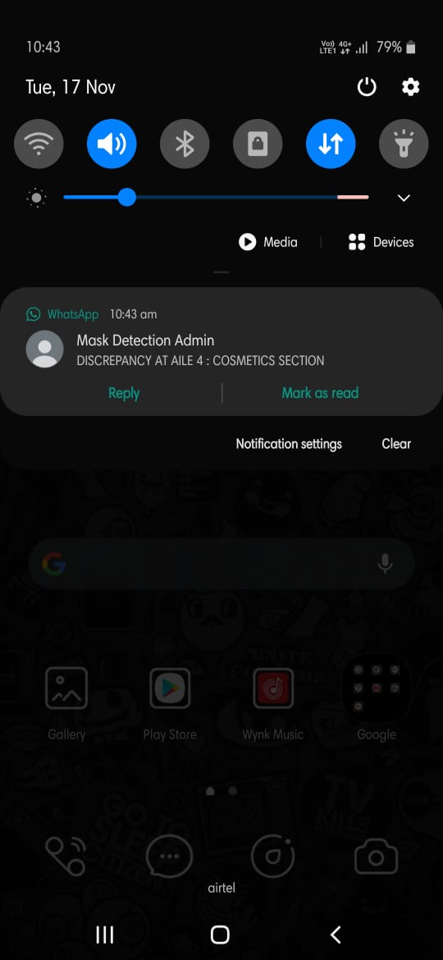
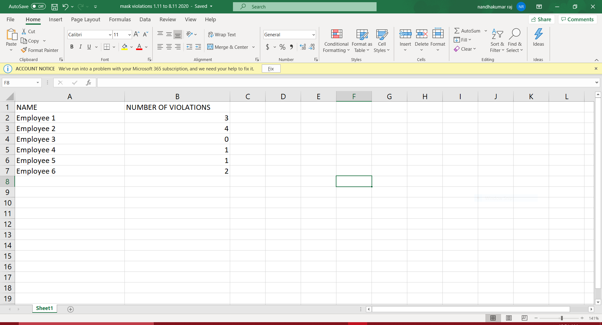
Develop a task analysis and define how users will interact with project

Slide 26
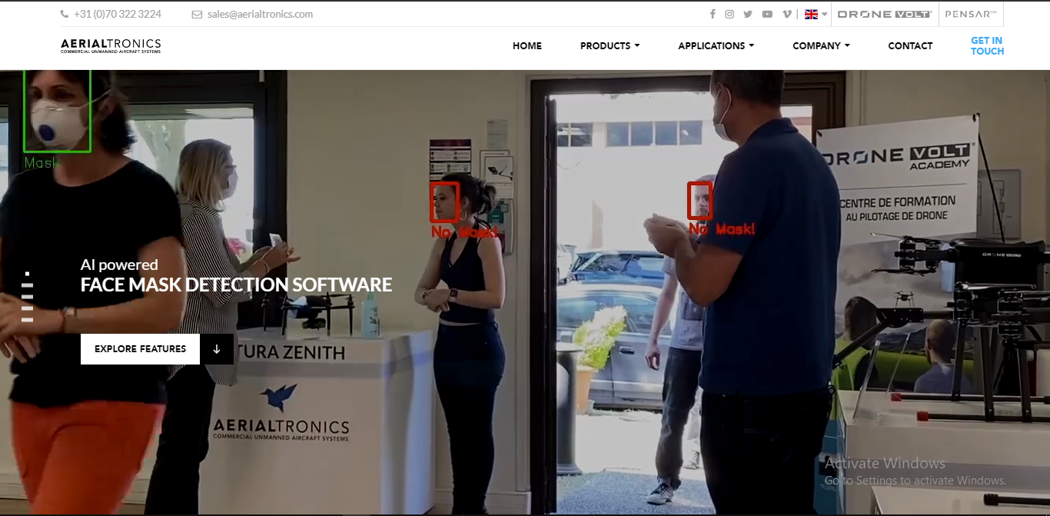
Compare to benchmark products (prior art)
Aerialtronics Mask Detector Software
Very Expensive to implement
No Face Recognition feature
No Notification Feature

Slide 27
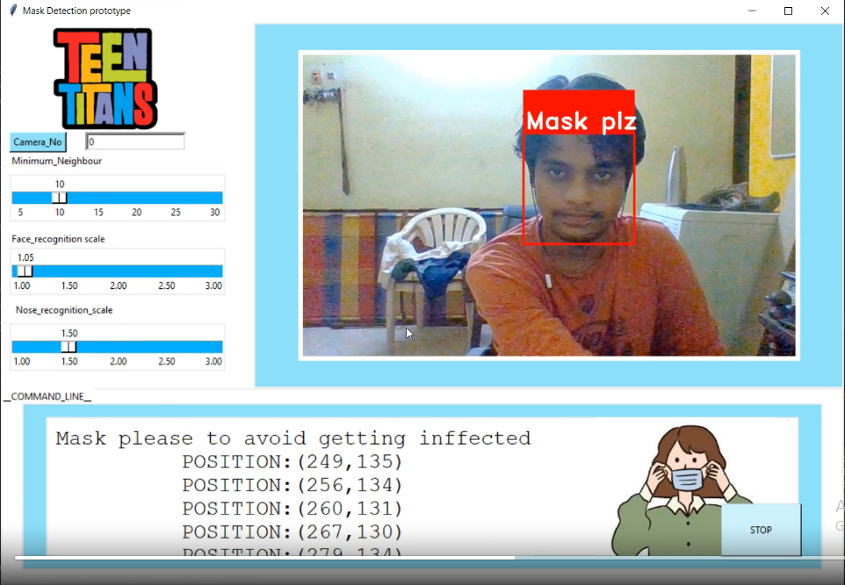
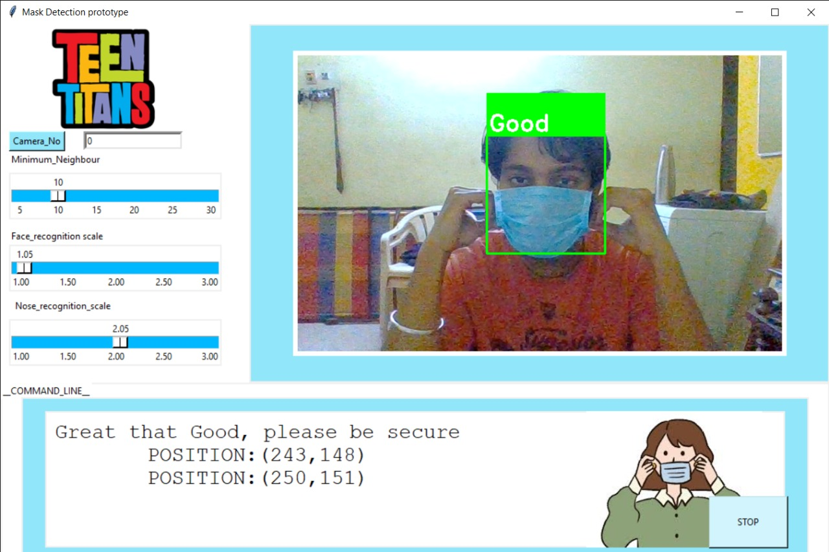
Compare to benchmark products (prior art)
Our Face Mask Detection
Very Accurate and Easy implementation
Face Recognition feature
Notification Feature

Slide 28
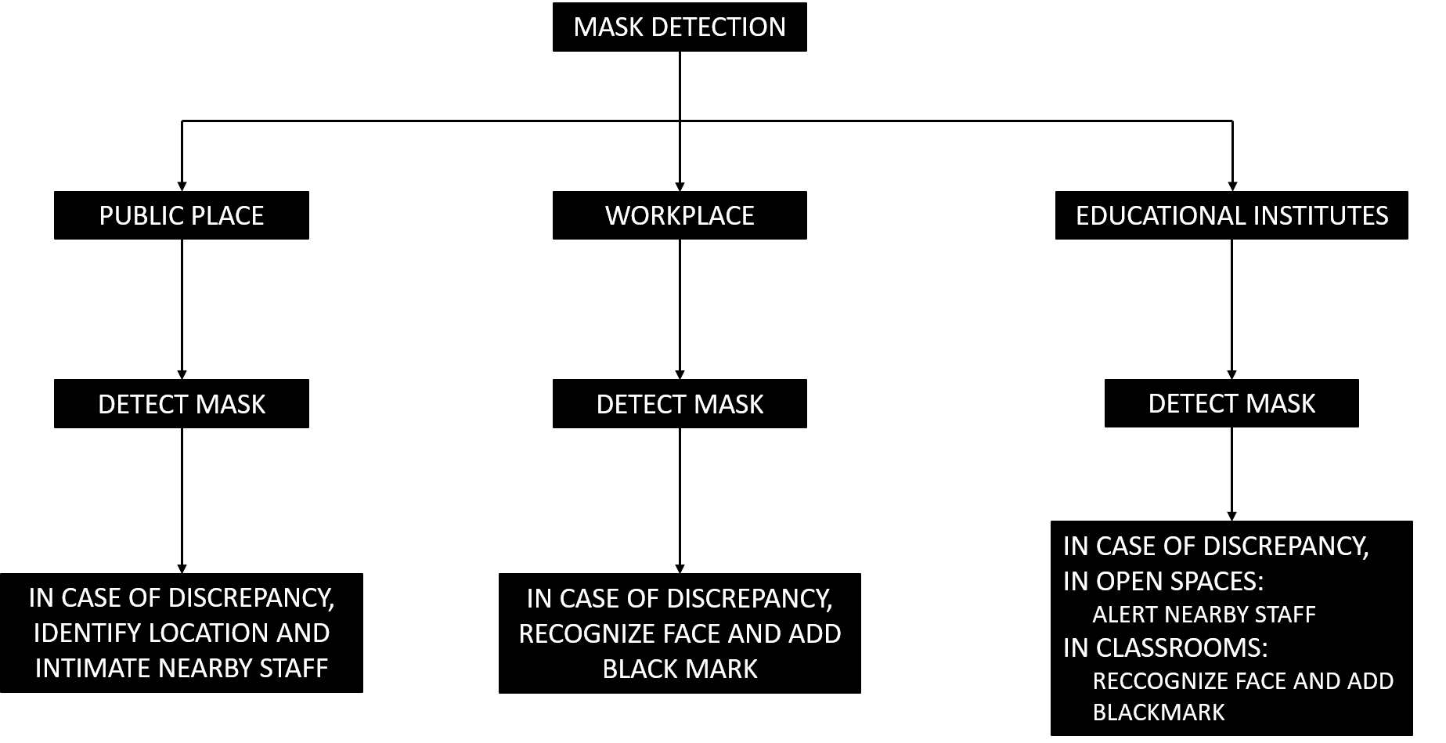
Functional Decomposition

Slide 29
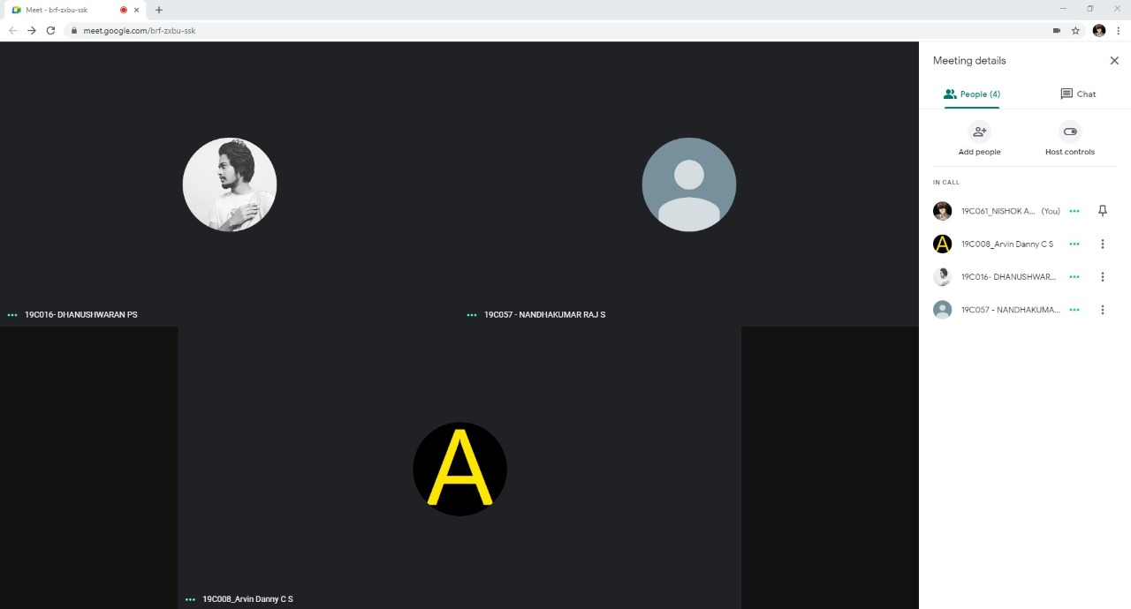
Brainstorming
BRAINSTORMING IDEAS:
Unique booths for checking
Facial recognition using cctv cameras
Facial recognition and alert system using cctv cameras

Slide 30
Starbusting
Monitor crowd and help curb irregularities.
Public places, workplaces and educational institutes
Using already installed cctv cameras.
WHAT
HOW
WHERE
WHY
WHO
To reduce risk of infection.
General public.
WHEN
24/7

Slide 31
Decision Matrix
S.NO. | IDEA | LIST CRITERION 1 | LIST CRITERION 2 | LIST CRITERION 3 | TOTAL SCORE
 |  | FEASIBILITY | IMPLEMENTATION | COST | /30
1 | UNIQUE BOOTHS FOR CHECKING | 3 | 7 | 6 | 16
2 | FACIAL RECOGNITION USING CCTV CAMERAS | 6 | 9 | 8 | 23
3 | FACIAL RECOGNITION AND ALERT SYSTEM USING CCTV CAMERAS | 9 | 9 | 7 | 25

Slide 32
Brainstorming 4-3-5
We should be able to recognize multiple defaulters simultaneously.
Easy to use.
The notifications could be made through whatsapp.
Should be able to detect even at low light.
Add an alert mode to alert if it is a public place.
Can be used in any environment :
1) public place variant
2) educational institutes / offices.
Maintain a record of defaulters.

Slide 33
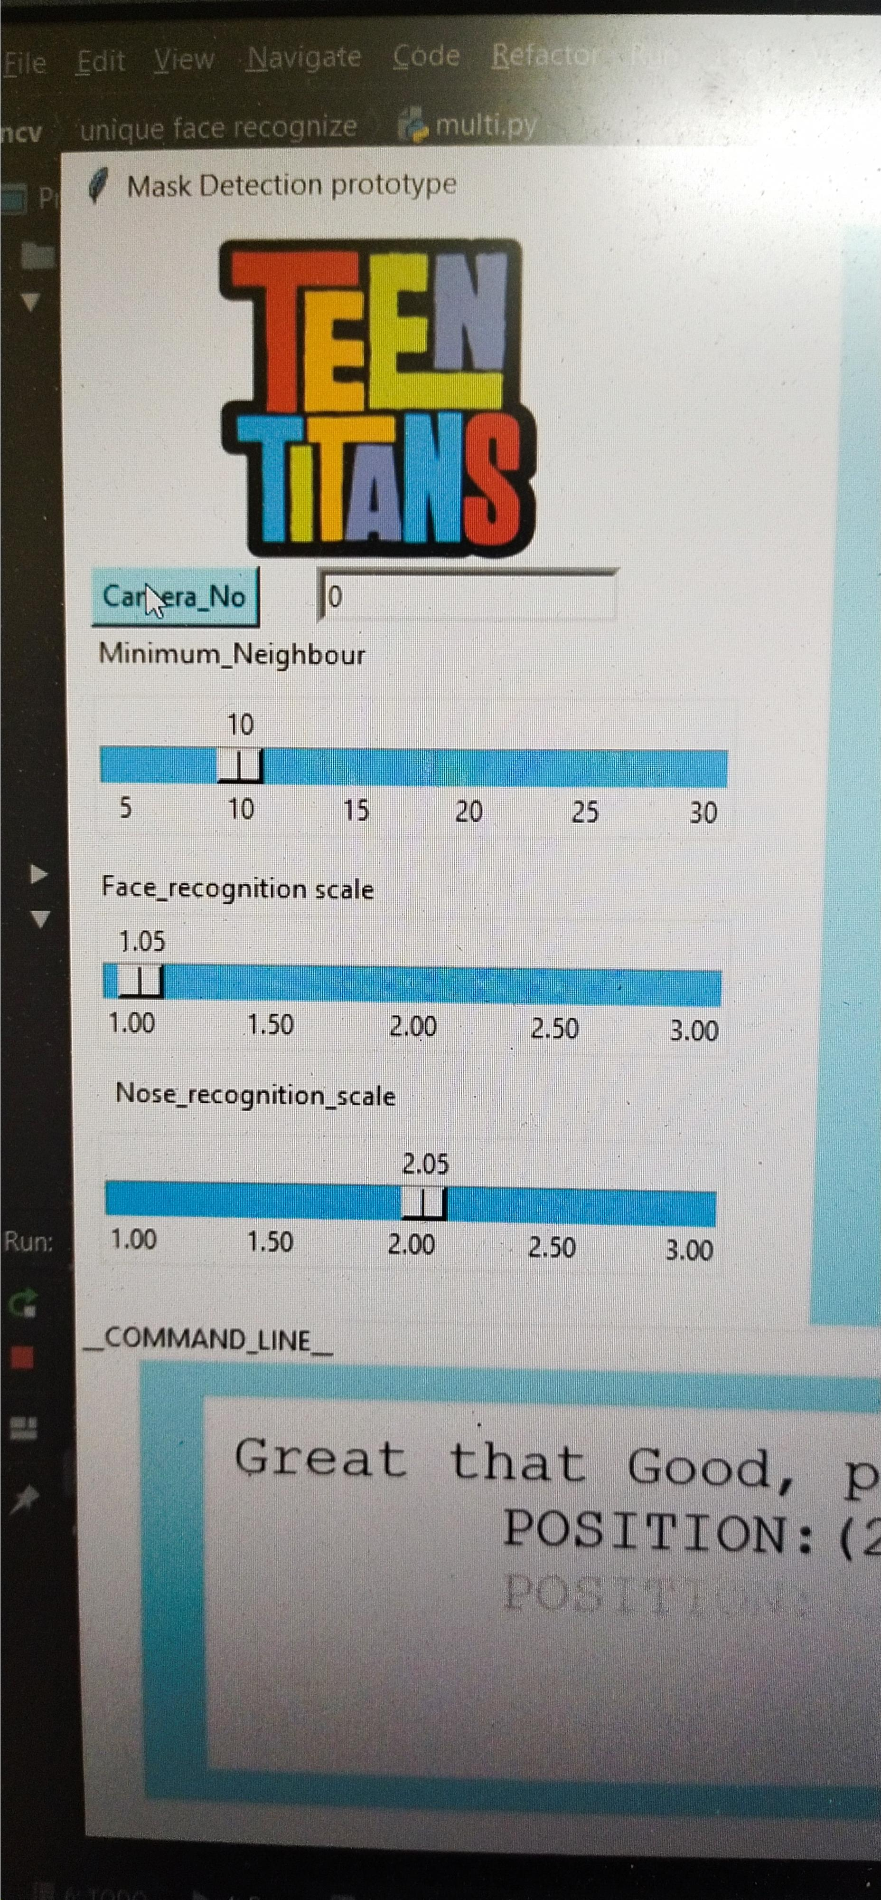
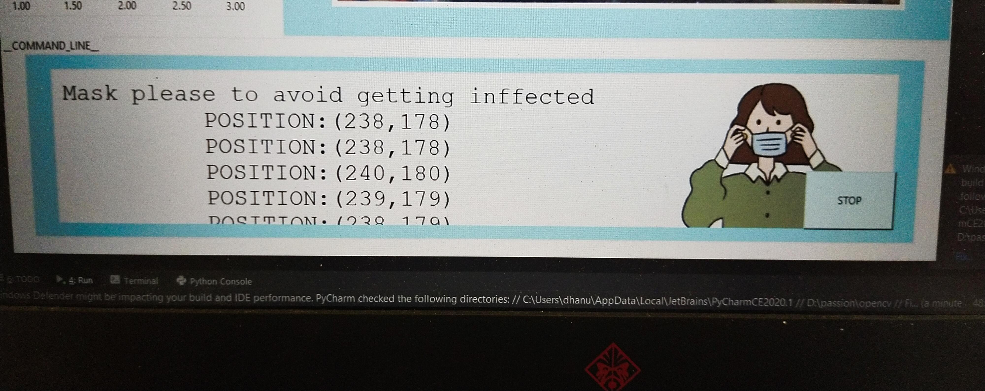
Conceptual Design
Tools for changing the detection Approximation

Slide 34

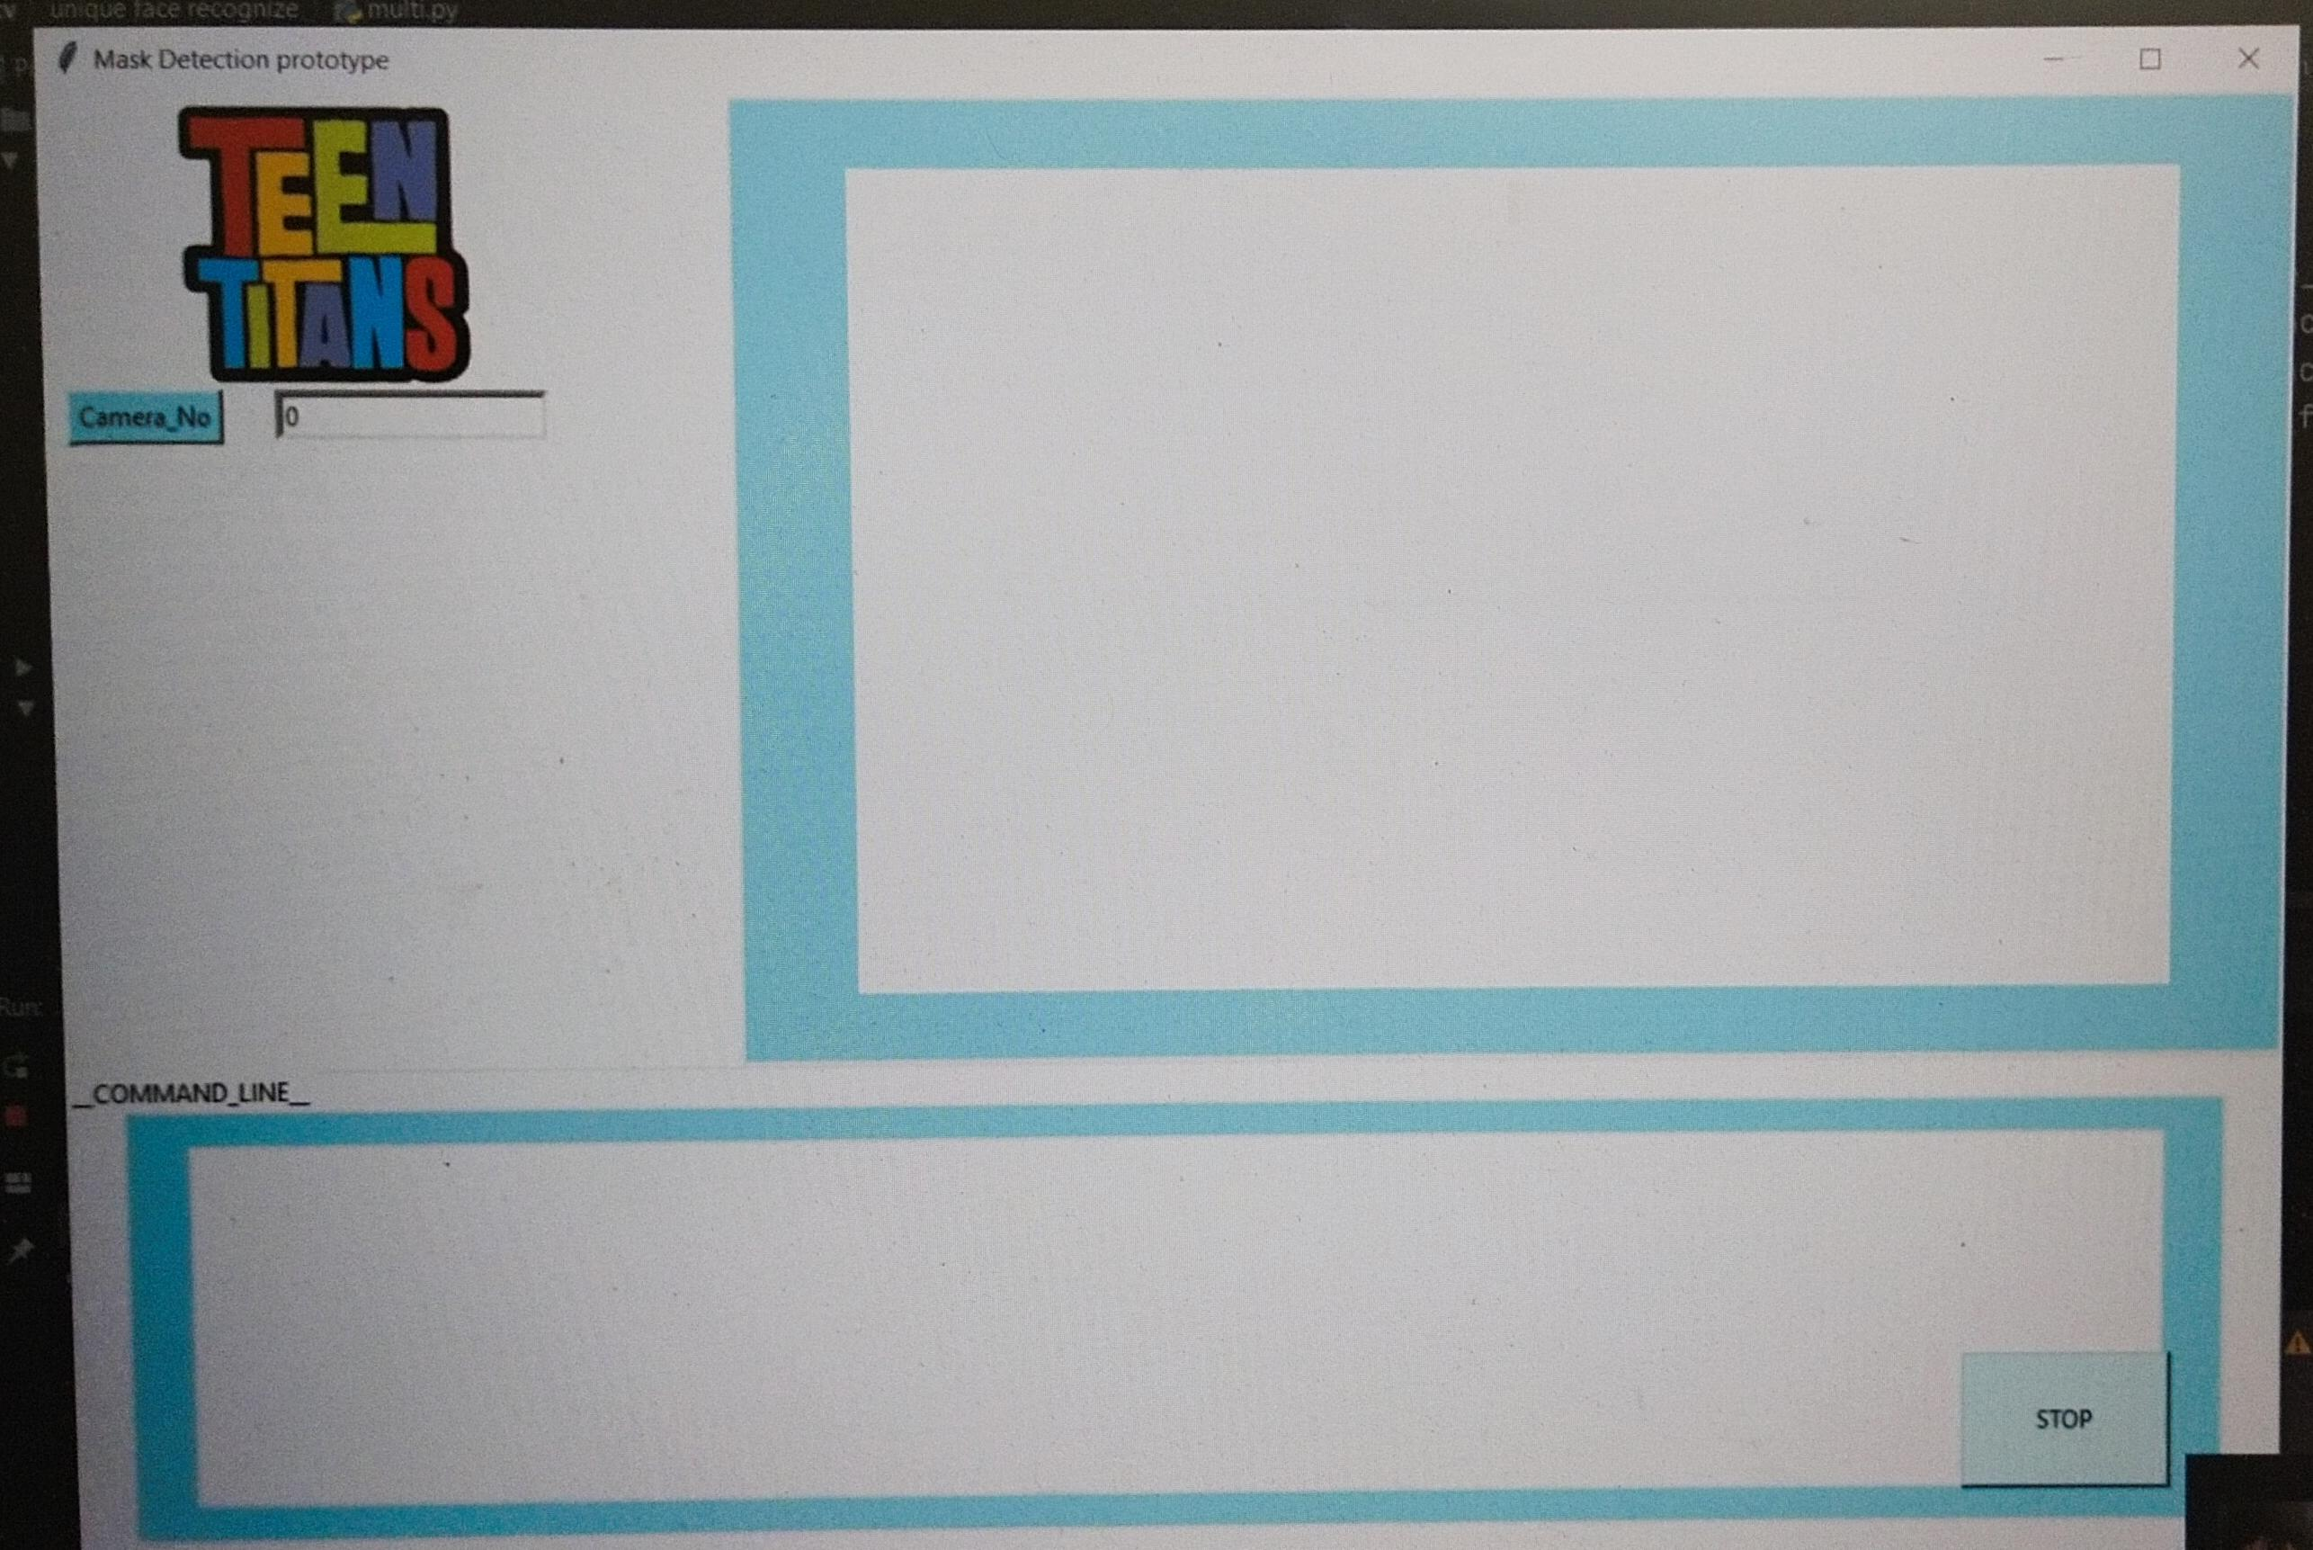
Output Screenshots
Front Page..
Concept layout

Slide 35
Conclusion
To mitigate the spread of COVID-19 pandemic, measures must be taken. This face mask detector can be deployed in many areas like shopping malls, workplaces and other places to monitor the public and to avoid the spread of the disease by checking who is following basic rules and who is not.
Thus we conclude that in accordance with our SDG goal i.e., for health and well being, we can create a safer environment.

Slide 36
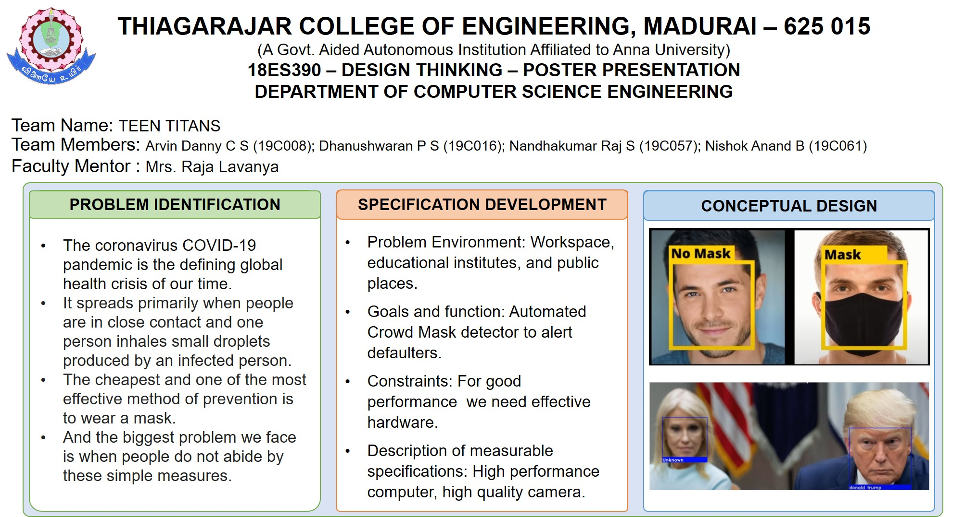
Participation and presentation Certificates of Poster/Prototype [If any]

Slide 37
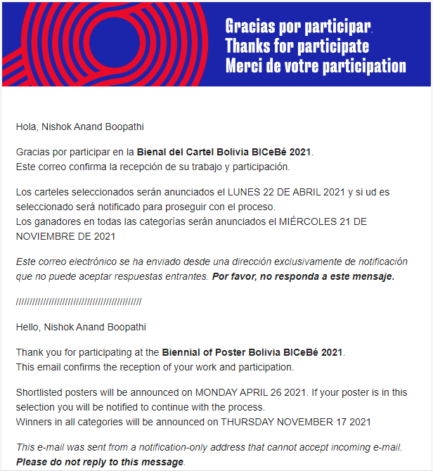
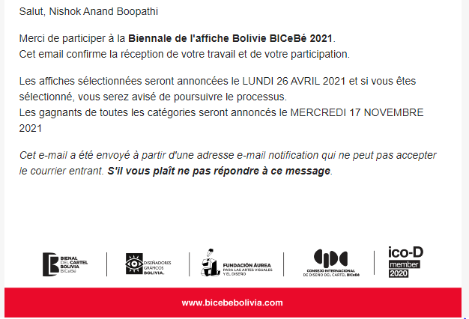

Slide 38
Gantt Chart-Schedule-Tracking
Graph:
AUG 2020
SEP 2020
OCT 2020
NOV 2020
DEC 2020
Start
Planning
Design discussion
Survey
implementation

Slide 39
THANK YOU

